Slide 1
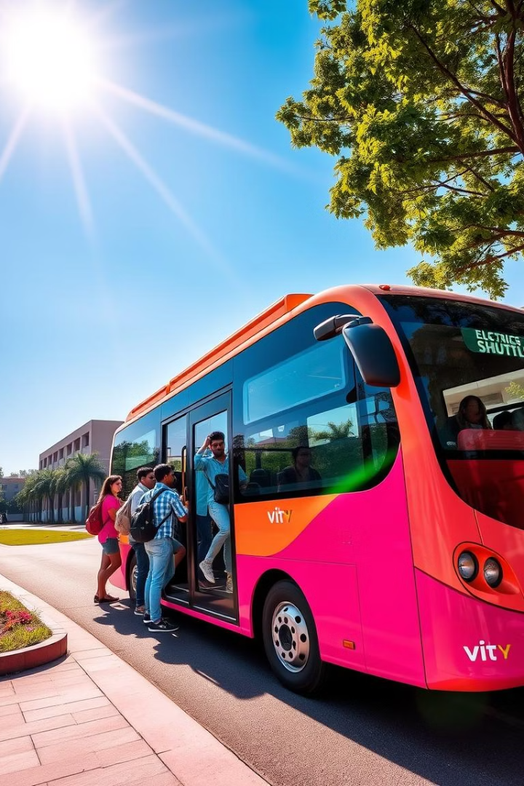
Shuttle Service Management System
This report details the proposed Shuttle Management System for VIT Campus.
This comprehensive solution optimizes shuttle operations. It also enhances the commuting experience for students and staff.
1
Project Guide: Dr. Srihari Mandava
Nikhil Kumar Kambampati (21BEC0856)
Vyshnavi Manthena (21BEE0311)
Navya Nair (21BEE0344)

Slide 2
Objective
To design and develop a Shuttle Service Management System using geofencing and the CAN protocol for secure and efficient campus transportation.
The system enables RFID-based payments, real-time shuttle tracking, and door status monitoring.
It provides comprehensive data on shuttle locations, geofence status, and daily transaction summaries.
A student app allows for wallet recharges, transaction history viewing, and shuttle tracking.
An operator app facilitates shuttle management and geofence control.

Slide 3
System Features Overview
Our Shuttle Service Management System seamlessly integrates cutting-edge technologies to revolutionize campus transportation.
RFID-Based Payment
Real-Time Shuttle Tracking
Enables students to make seamless, contactless payments using RFID cards. Fare is automatically deducted, reducing transaction time and eliminating the need for cash handling.
GPS modules provide live location data of each shuttle, which is displayed on web dashboards for both students and administrators, enhancing route visibility and scheduling efficiency.
Speed-Based Door Monitoring
Online Wallet Recharge
A safety feature that triggers a buzzer alert if the shuttle doors remain open while the vehicle is in motion, ensuring passenger safety.
Integration with Razorpay allows students to recharge their RFID wallets via an online payment gateway, offering convenience and reducing manual recharge processes.
Geofencing Control
Cloud-Based Data Management
Virtual boundaries are set using GPS data. Alerts are generated if a shuttle enters or exits predefined zones, allowing operators to ensure compliance with designated routes.
The system uses WebSocket for real-time data synchronization and secure storage of transaction history, shuttle logs, and geofence status on the cloud.
Student Mobile App
Operator App
Track shuttles in real-time
Real-time fleet status
View transaction history
Geofence controls
Recharge RFID wallet
Door status monitoring
Daily operation summaries

Slide 4
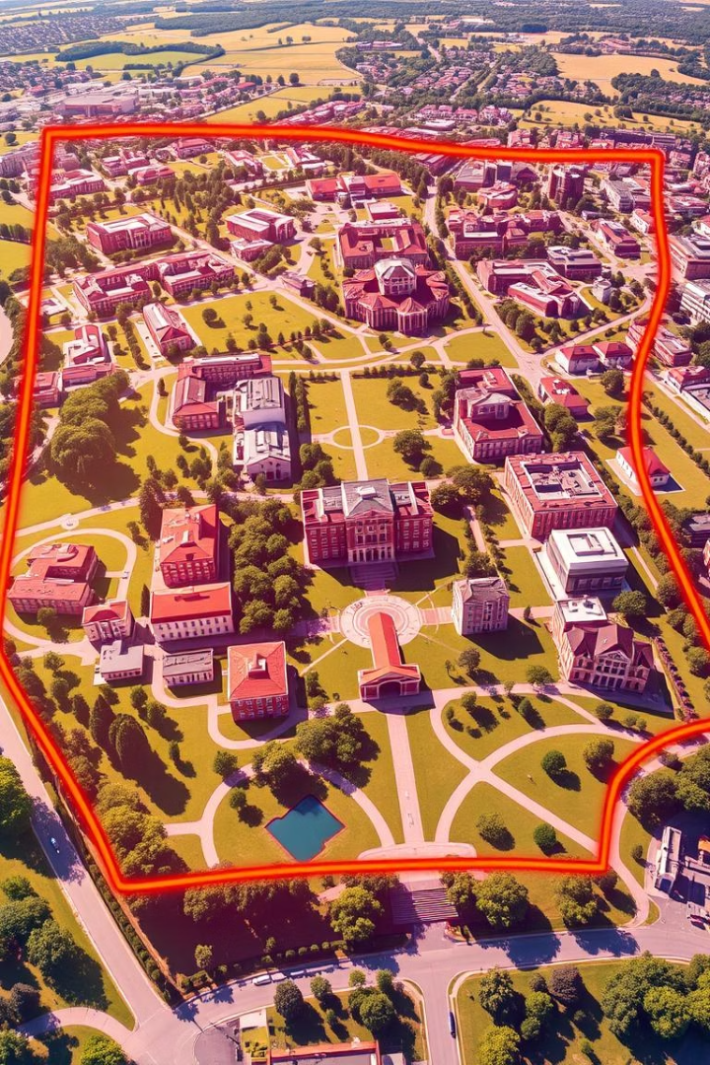
System Flow Visualization
The system involves several key steps for efficient operation.
RFID Card Tap
1
The student taps their RFID card on the shuttle's RFID reader. The ESP32 verifies the card and deducts fare from the wallet.
2
Transaction Logging
Payment details are logged and sent to the cloud using WebSocket. Students can view this data in their app under transaction history.
Shuttle Speed Monitoring
3
The system continuously monitors speed using a servo-based angle system. If the shuttle is moving and the door is open, a buzzer alert is triggered for safety.
4
GPS Location Tracking
The shuttle's GPS module transmits real-time coordinates. Location data is updated on a web dashboard via WebSocket and shown using the Google Maps API.
Geofencing Enforcement
5
The system checks if the shuttle is operating within its designated geofence zone. Any breach triggers a notification to the operator via the app.
6
Data Synchronization & Display
All transaction, location, and safety data is sent to the cloud in real-time. Students and admins access dashboards hosted on Vercel for live updates.

Slide 5
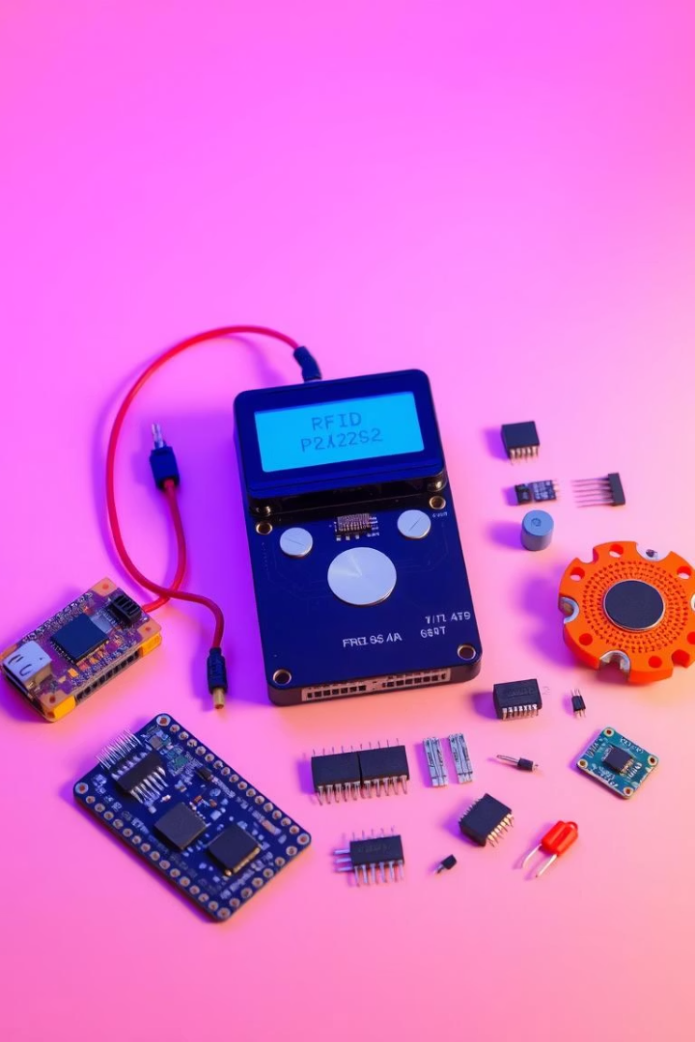
Hardware Requirements
The system requires the following hardware components:
1
ESP32 (x3)
Microcontrollers for RFID, GPS, and door monitoring systems
2
MFRC522 RFID Reader
Handles RFID card scans and initiates fare transactions
3
OLED Display
Displays payment status, errors, and alerts to passengers
4
MCP2515 CAN Module
Facilitates communication between multiple ESP32 nodes via CAN bus
5
Buzzer
Alerts when shuttle is moving with doors open (safety feature)
6
GPS Module
Captures real-time shuttle location for tracking and geofencing
7
Servo Motor
Estimates shuttle movement and speed for door alert logic
8
DC Motor
Simulates shuttle movement in prototype/demo scenarios

Slide 6
Software Requirements
The software components that enable the seamless operation of the Shuttle Service Management System:
1
Arduino IDE
2
WebSocket
3
Google Maps API
For writing and uploading firmware to ESP32s
Ensures real-time data sync for transactions and GPS updates
Visualizes shuttle location on student/admin dashboard
4
Vercel
5
Razorpay API
6
CAN Bus Protocol
Hosts the web interface for dashboard access
Facilitates secure online payments for wallet recharge
Enables reliable, low-latency communication between microcontrollers
7
Custom API Integration
Connects front-end apps with backend services for data flow

Slide 7
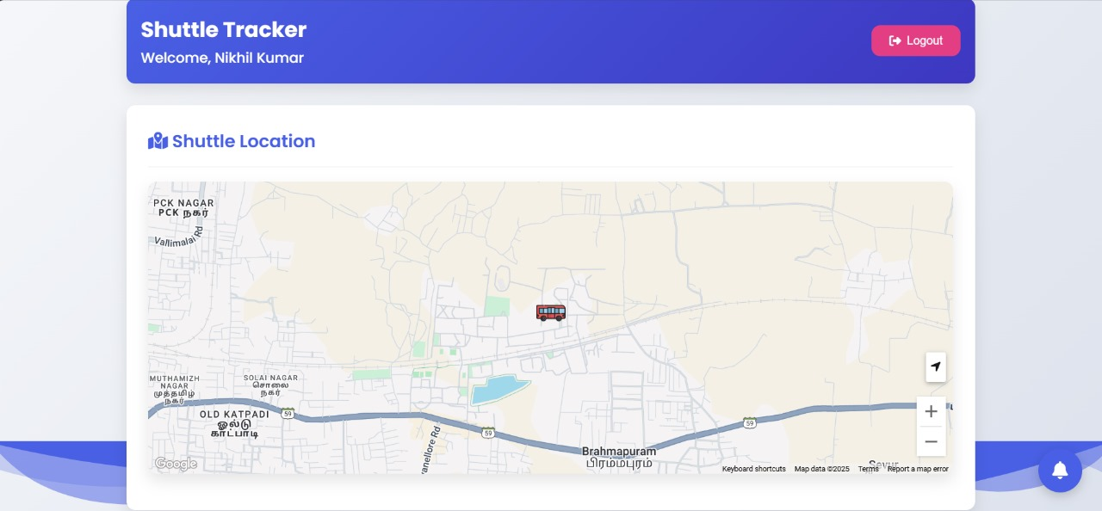
Dashboard

Slide 8
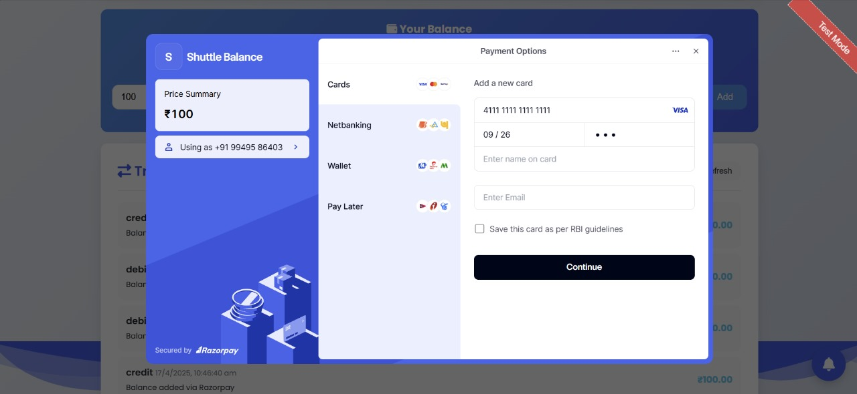

Slide 9
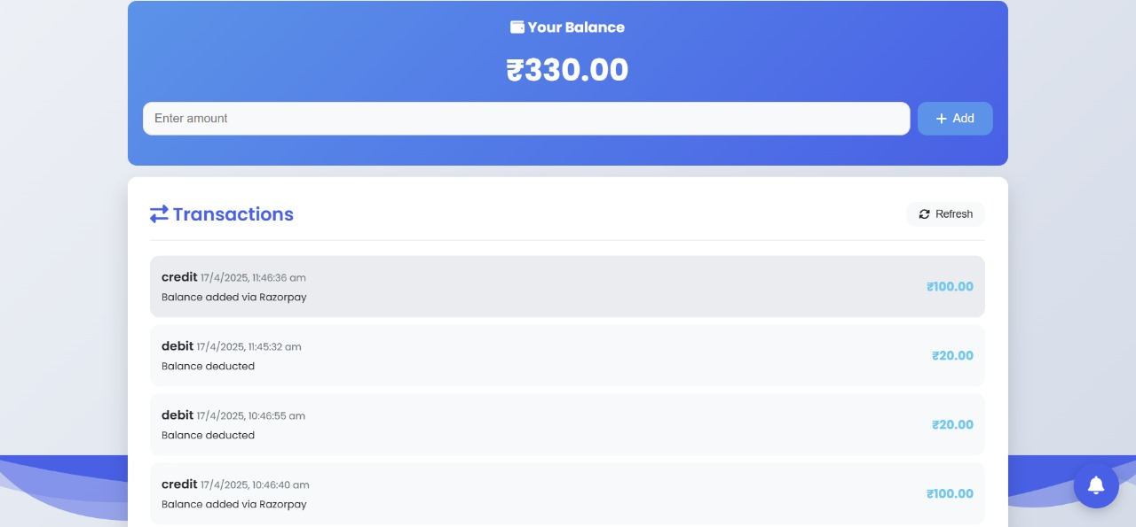

Slide 10
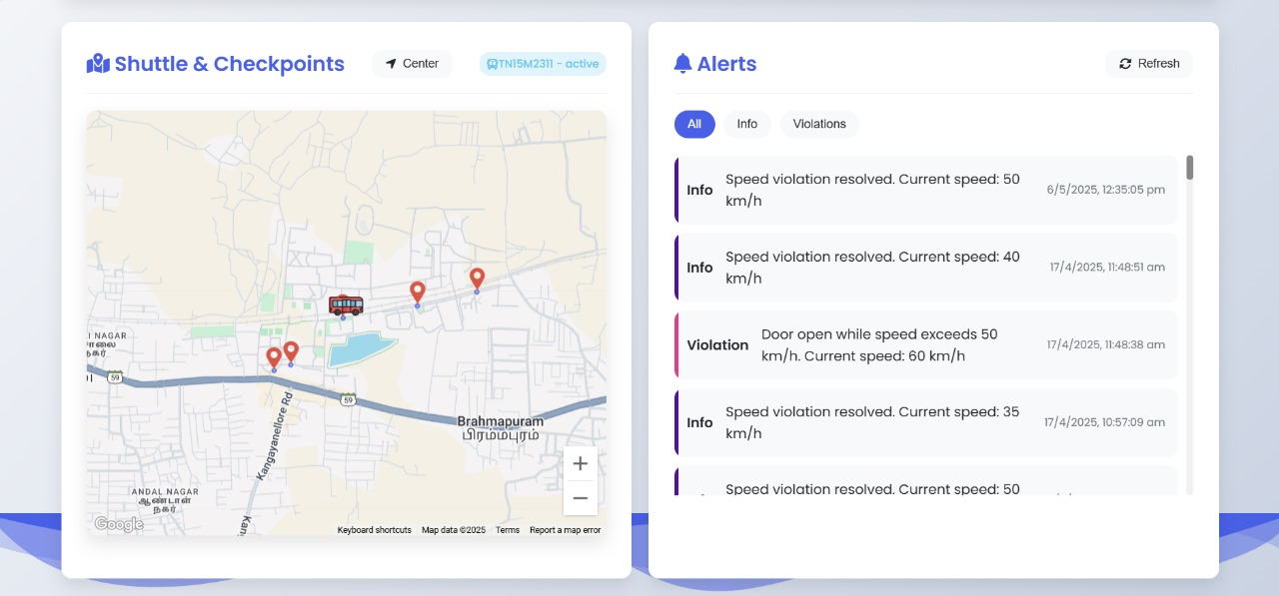

Slide 11

References
Geofencing for Tracking Mobile Objects The paper discusses the use of geofencing for tracking mobile objects through telematics and satellite positioning. It highlights the ability to detect when vehicles enter or exit geofenced areas in real time. The concept of creating restricted access areas, such as for specific routes or zones, is also explored to enhance monitoring and control. Additionally, the paper reviews applications of geofencing in transport systems, where it contributes to improved operational efficiency and safety.
CAN Protocol Implementation The paper provides insights into implementing the CAN protocol for communication between nodes using MCP2515 CAN controllers and TJA1050 transceivers. It discusses the methodology for setting up CAN communication in a network, enabling efficient data exchange between devices. The paper also explains the use of CAN controllers and transceivers to establish reliable communication for real-time monitoring and control systems in various applications.
RFID-Based Mobile Payment System The reference paper proposes an RFID-based GPRS mobile payment system, utilizing existing GSM networks for cost-effective implementation. It focuses on integrating RFID technology for seamless payments through mobile communication systems, offering an affordable solution for mobile payment systems. The system is designed to ensure easy implementation using GSM networks, providing a reliable and efficient mobile payment method without the need for specialized hardware.
Vehicle Tracking using GPS and Mobile Communication The paper presents a vehicle tracking system using GPS and mobile communication. It integrates the Google Maps API to display the vehicle's location on a smartphone app, allowing users to track the vehicle's movement and determine the distance to a destination. Users receive notifications when the vehicle enters or exits a geofenced area. The system also allows users to view the vehicle's location, check the distance, browse news, update profiles, and record grievances.

Slide 12
Conclusion
The Shuttle Service Management System successfully integrates IoT technologies to automate shuttle operations and improve campus transportation.
By combining RFID payments, real-time GPS tracking, geofencing, and CAN protocol, the system ensures safety, efficiency, and user convenience.
Its modular and scalable design makes it adaptable for educational campuses, corporate environments, and future upgrades like analytics and multi-shuttle support.

